Slide 1
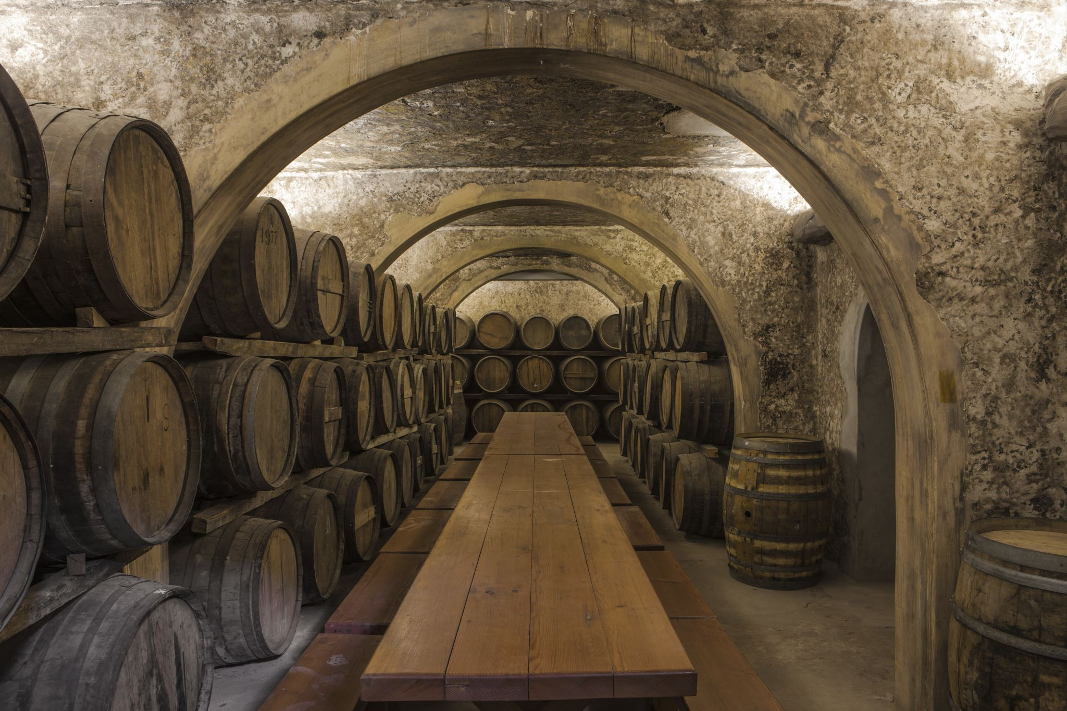
Bacchus Winery Case Study
CSD 310 Assignment 11.2 Milestone #4

Slide 2
Meet the Delta Team
Paul Fralix
Sylvester Brandon
Reed Bunnell
Tyler Freese

Slide 3

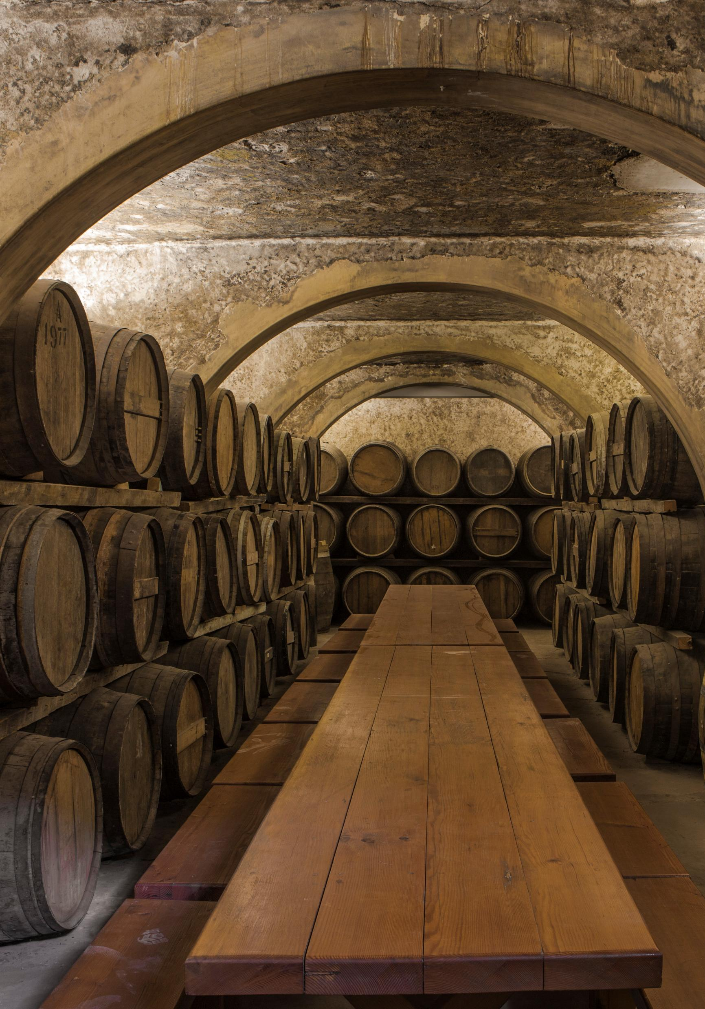
Case Study Overview
Stan and Davis Bacchus inherited Bacchus Winery from their father, George.
They aim to modernize business processes.
The processes include supply tracking, wine distribution, sales performance, and employee time tracking.

Slide 4
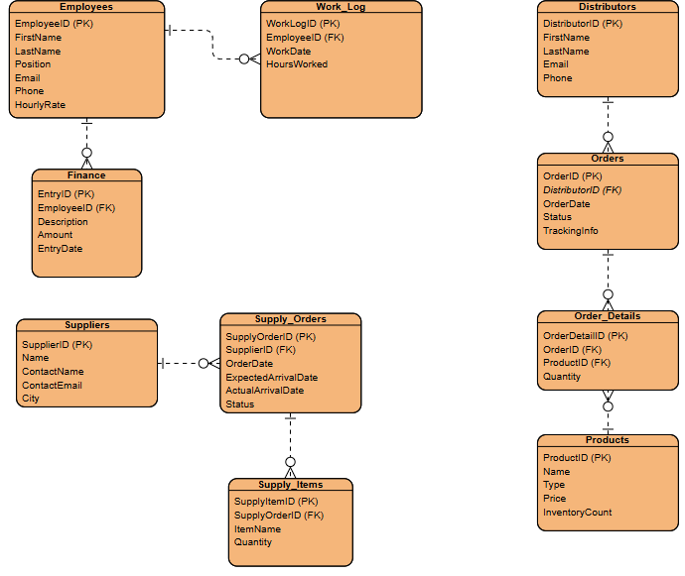
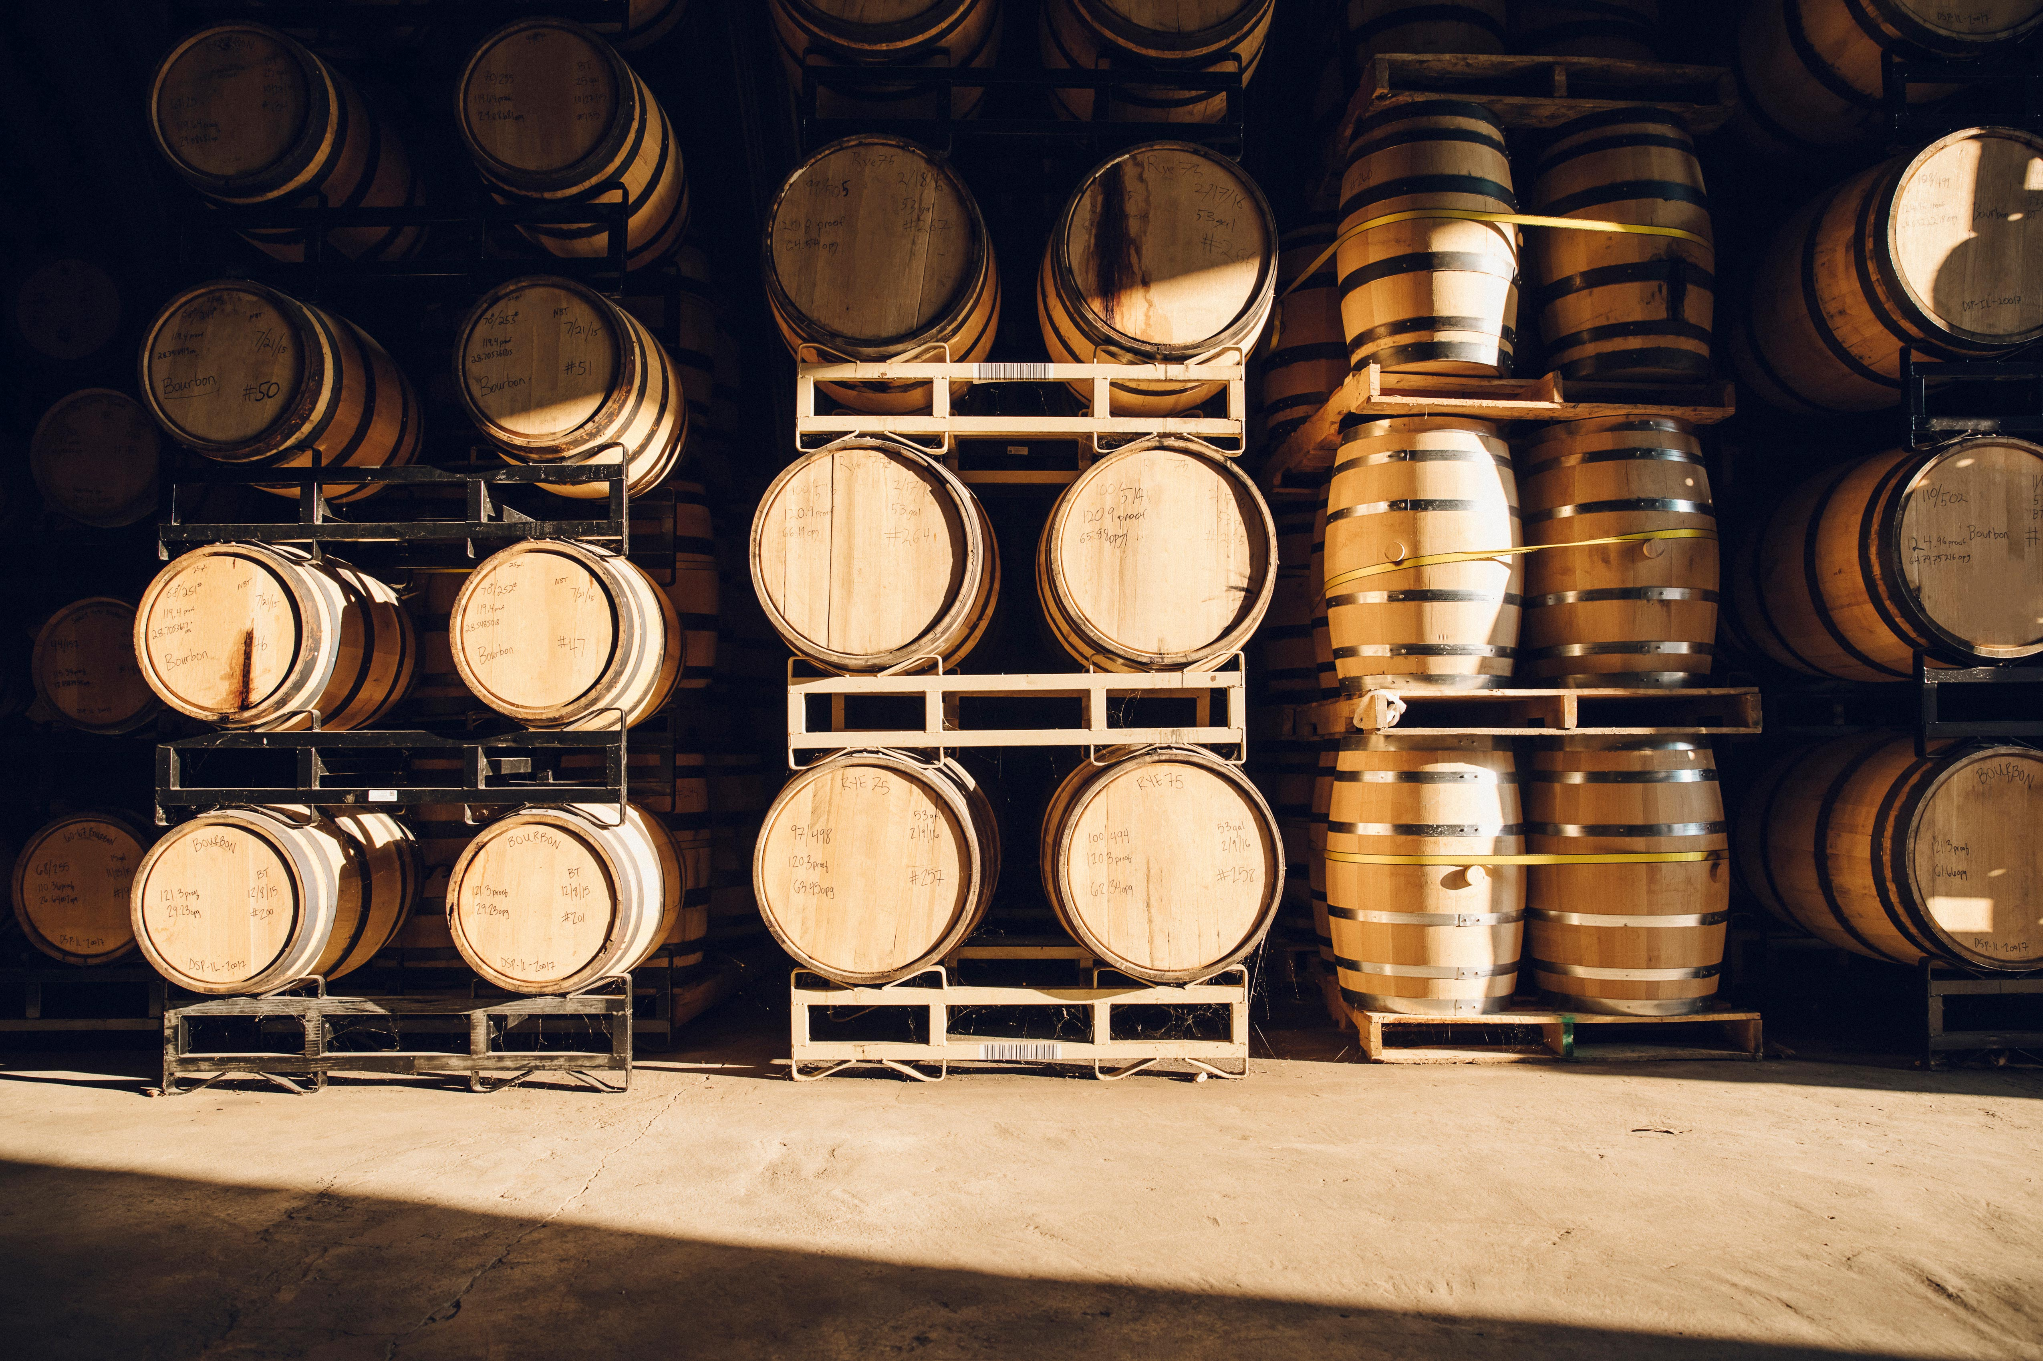
Bacchus Winery Finalized ERD Diagram

Slide 5
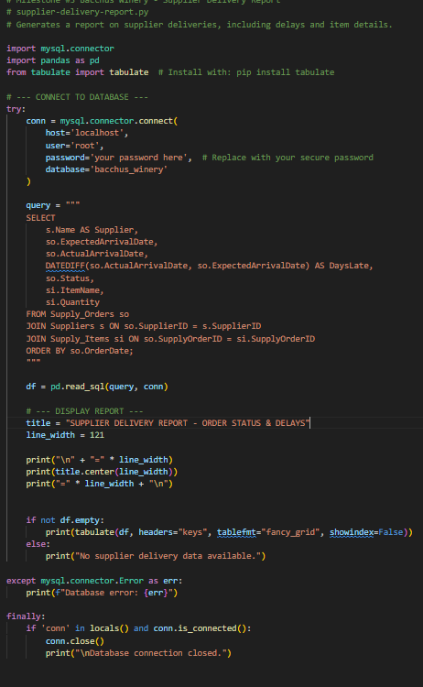
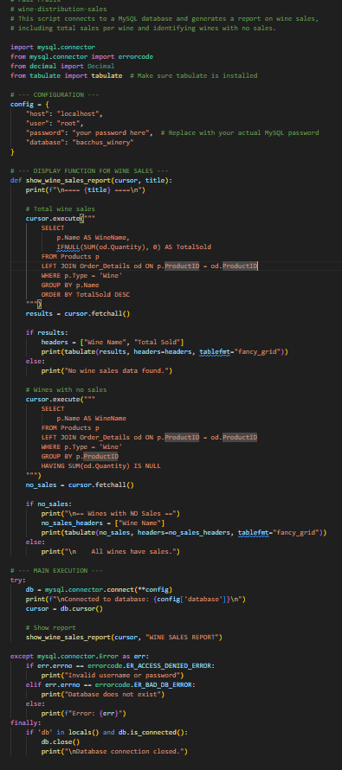
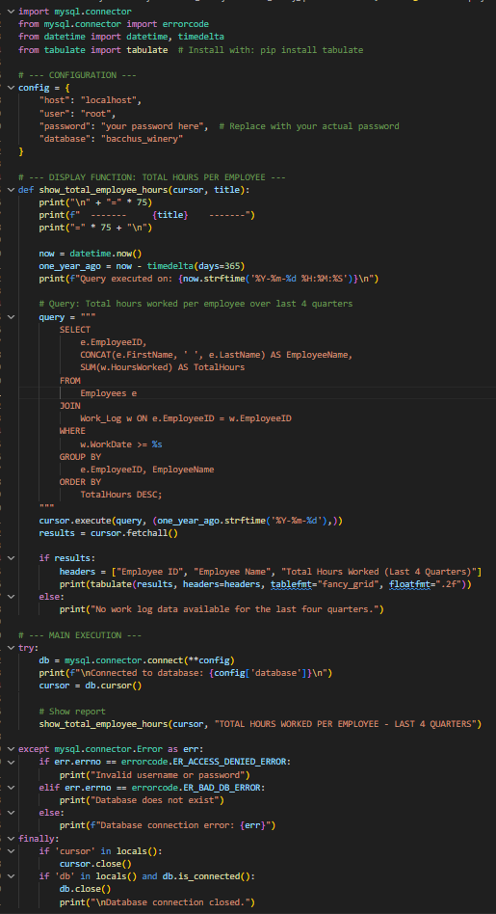
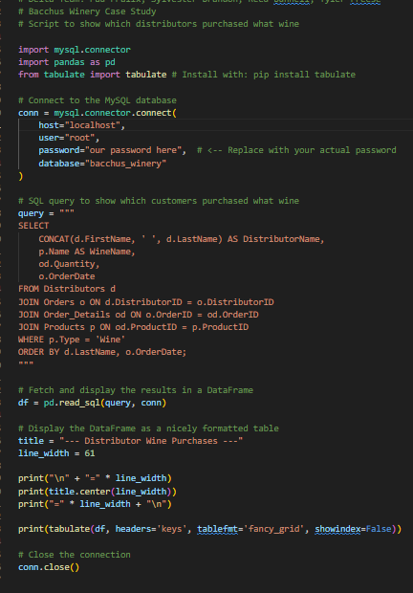
Reports Generated
• Supplier Delivery Report – Tracks delivery delays and quantities.
• Wine Sales Report – Summarizes wine product performance.
• Employee Hours Report – Summarizes hours worked per employee.
• Distributor Wine Purchases – Identifies which distributor buys what wine and how often.

Slide 6
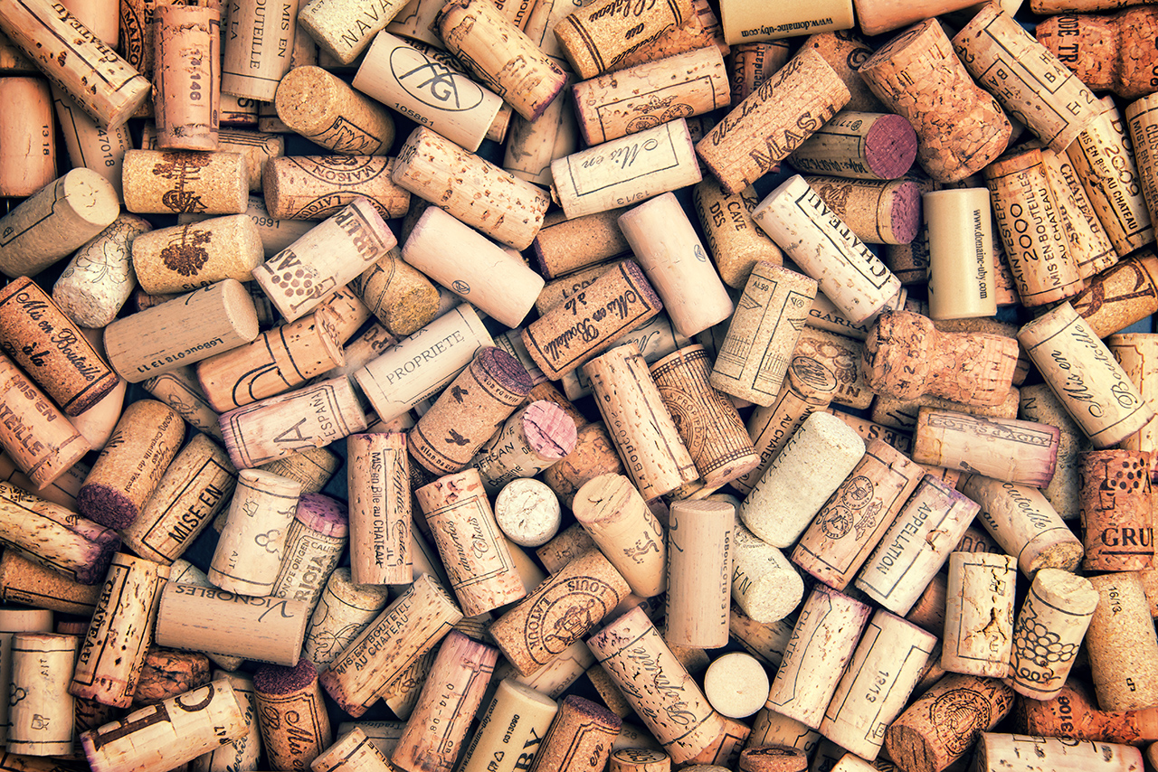
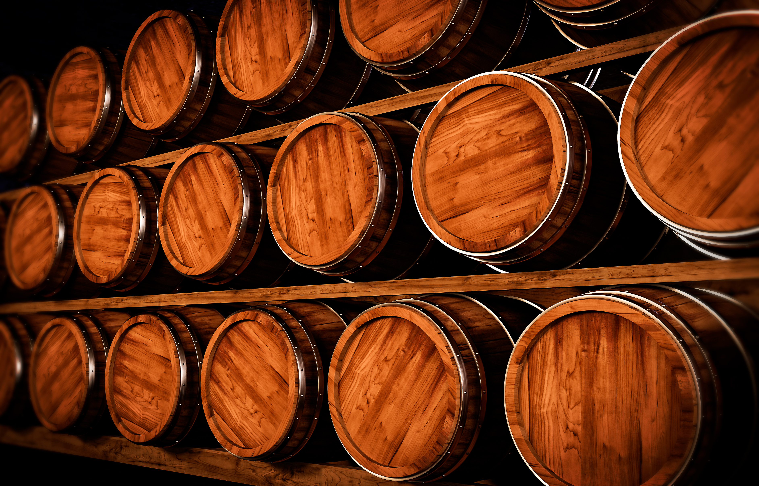
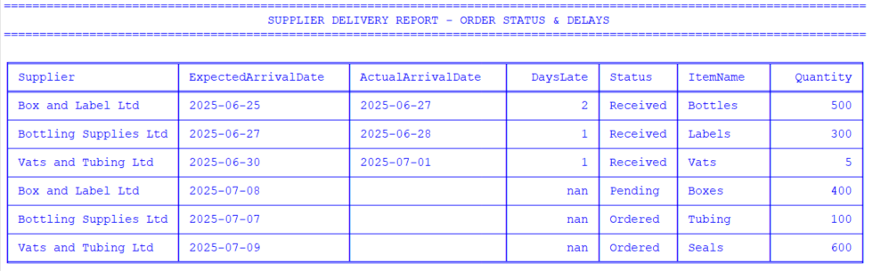

Supplier Delivery Report
Question: Are all suppliers delivering on time? Is there a large gap between expected delivery and actual delivery?
This report uses the ExpectedArrivalDate and the ActualArrivalDate to calculate delays.
The report also shows the status and quantity of each delivery.

Slide 7
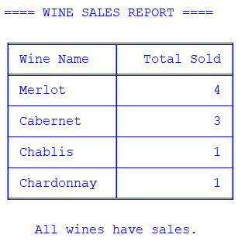
Wine Sales Report
Question: Regarding wine distribution, are all wines selling as they thought? Is one wine not selling?
This report calculates the sales of each wine and advises if a wine does not have any sales.
Observation: All wines have recorded sales. Merlot is the best seller. While Chablis and Chardonnay are low, possible targets for improved marketing or promotion.

Slide 8
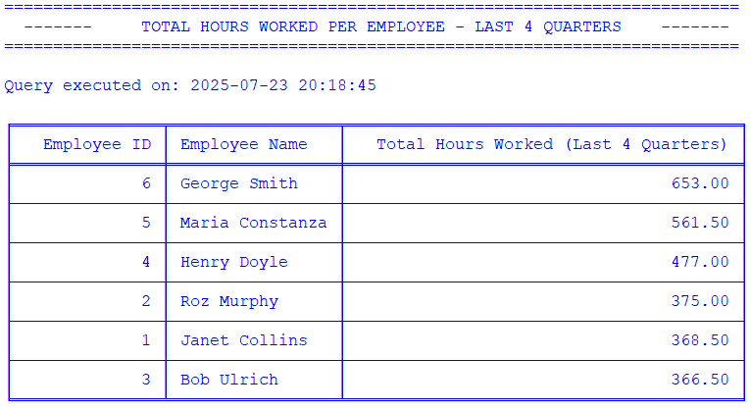
Employee Hours Report
Question: Employee time. During the last four quarters, how many hours did each employee work?
This report calculates the total hours worked for each employee over the last four (4) quarters.
Observations:
Operations and Distribution staff (George, Maria) logged the most hours.
Marketing staff like Bob logged fewer, possibly due to seasonal work or missing logs.
It can help Stan and Davis assess whether resource allocation is aligned with needs.

Slide 9
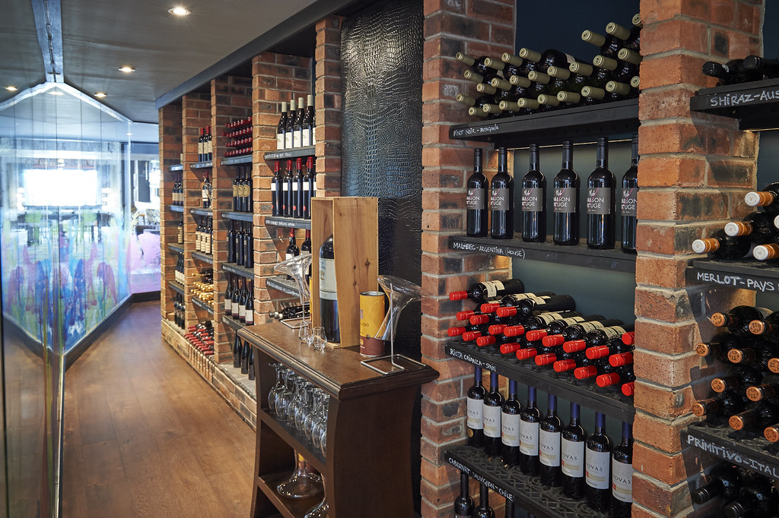
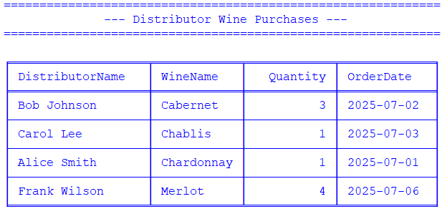
Distributor Wine Purchases
Question: Which distributor carries which wine?
This report shows which wine each distributor purchased, including the quantity, and the date purchased.
This Photo by Unknown Author is licensed under CC BY-ND

Slide 10
Assumptions that were made in the design creation.
All employees are salaried/hourly and track hours via logs
Each Supplier delivers multiple items (bottles, labels, etc.)
Distributors place orders that include one or more wine products.
Inventory quantities and product sales are updated per order.
Deliveries are recorded with both expected and actual dates.

Slide 11
Business Impact & Next Steps
Data-driven visibility into employees, sales, and supply chain.
Merlot is the top-selling wine; Cabernet needs promotion.
Suppliers are often 1–2 days late. May want to consider alternatives.
System ready for online tracking, ordering, and future expansion.

Slide 12
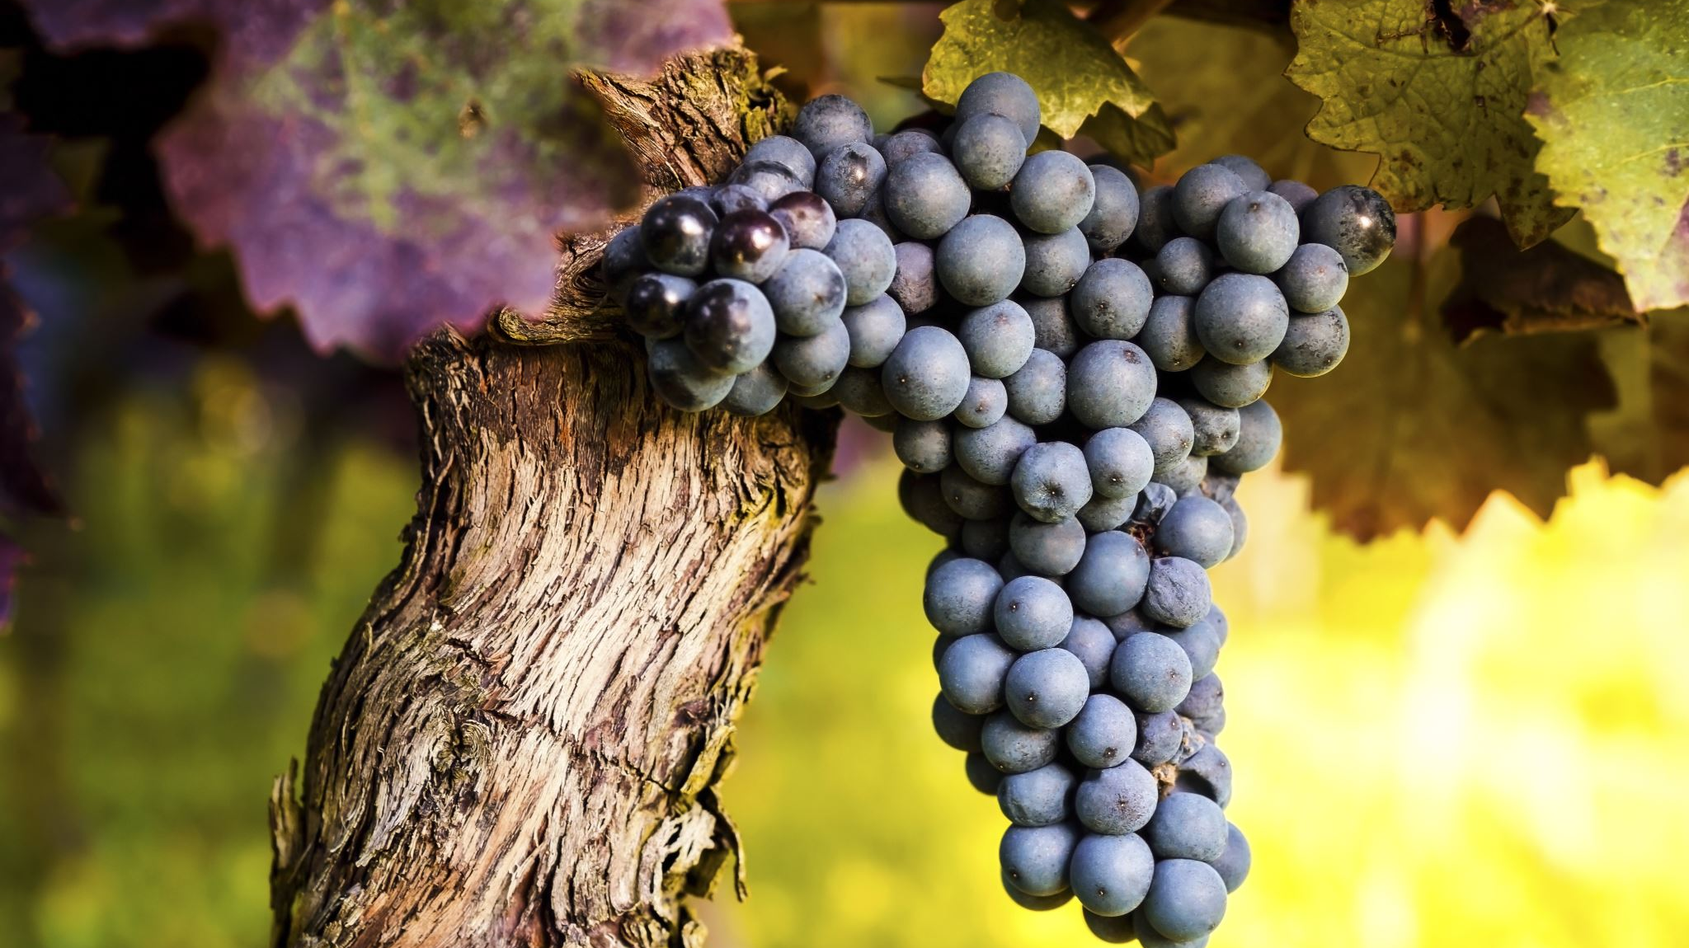
Bacchus Winery
Thank You from the Delta Team

